Slide 1

Capstone Project Retail and Marketing analysis
File created by: Sachin Prajapati

Slide 2
AGENDA
Problem Statement
Key Insights
Recommendation
Appendix:
Data methodology

Slide 3
Problem Statement
OList is one such e-commerce company that has faced some losses recently and they want to manage their inventory very well so as to reduce any unnecessary costs that they might be bearing.
You need to identify top products that contribute to the revenue and also use market basket analysis to analyse the purchase behaviour of individual customers to estimate with relative certainty, what items are more likely to be purchased individually or in combination with some other products.

Slide 4
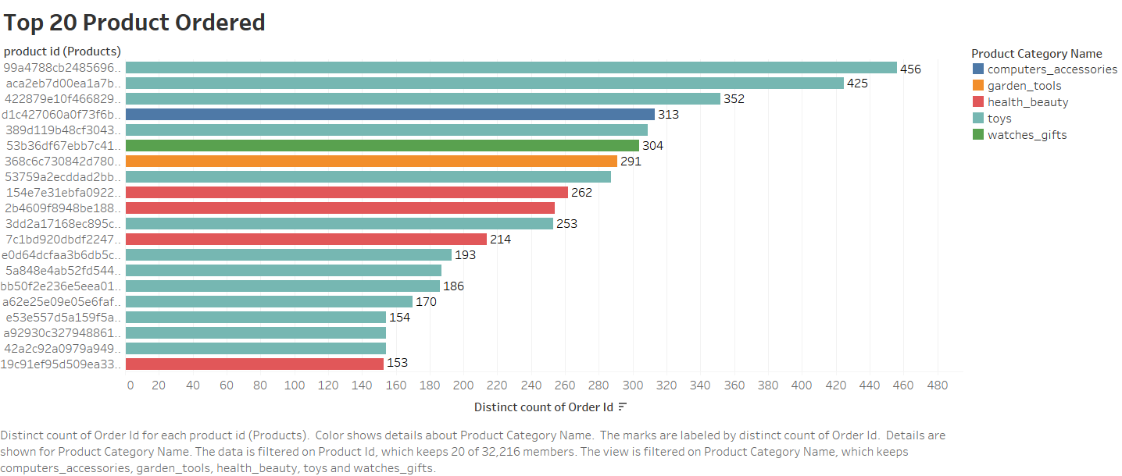
This bar chart gives us the Top 20 Products which are ordered by quantity .
This also shows us that the product category (toys) are the most frequent ordered products.

Slide 5
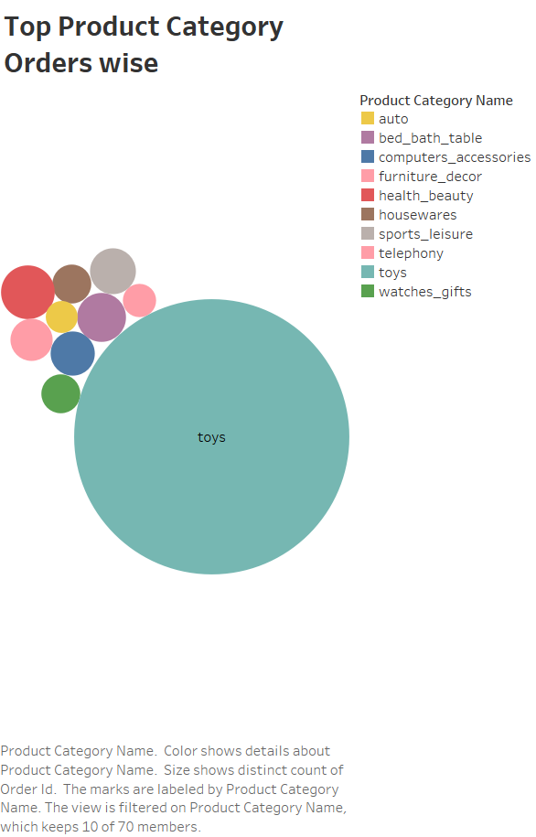
This Bubble chart shows us the top 10 product category out of 70 with most number of product ordered.
This also gives us insight that apart from toys health_beauty is ordered frequently.

Slide 6
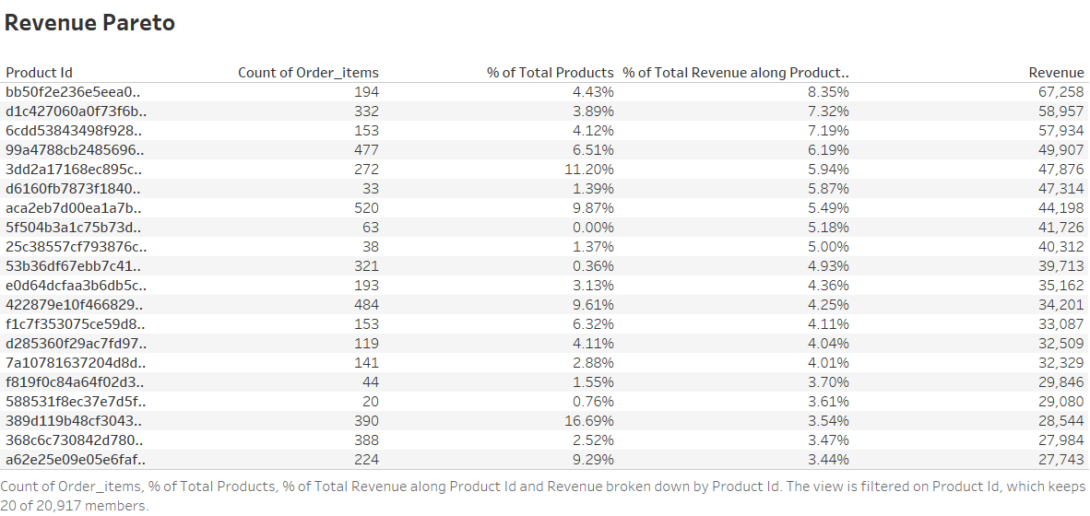
The following revenue pareto chart tells us the amount of revenue generated by each product.
This also shows us the running % Total revenue along with product_id.
We can add more measures as the measure names are included in the filter.

Slide 7
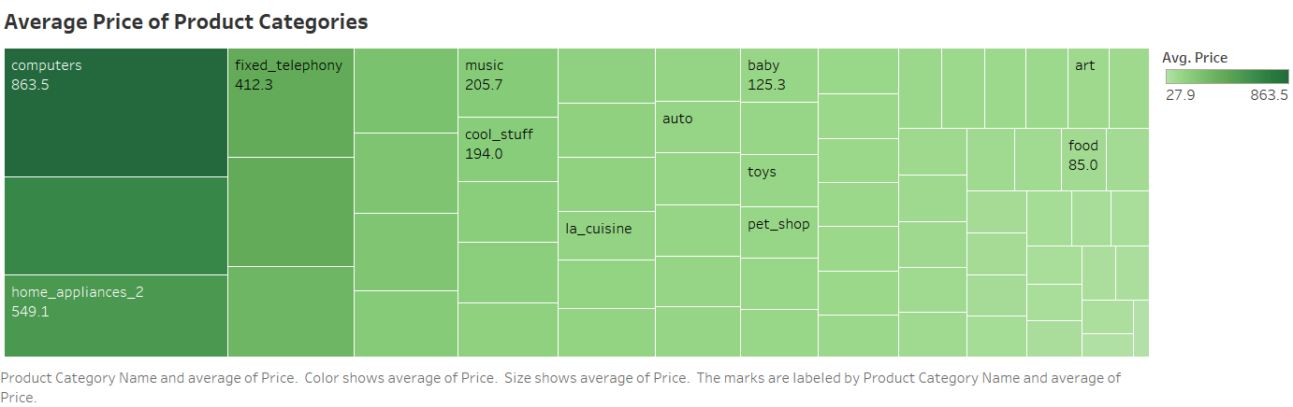
This tree map gives us insight about the average price of each product category.
As we can see the computers product category has the highest average price of 863.5
This also concludes that toys are the most ordered products but the average price is not that much high.

Slide 8
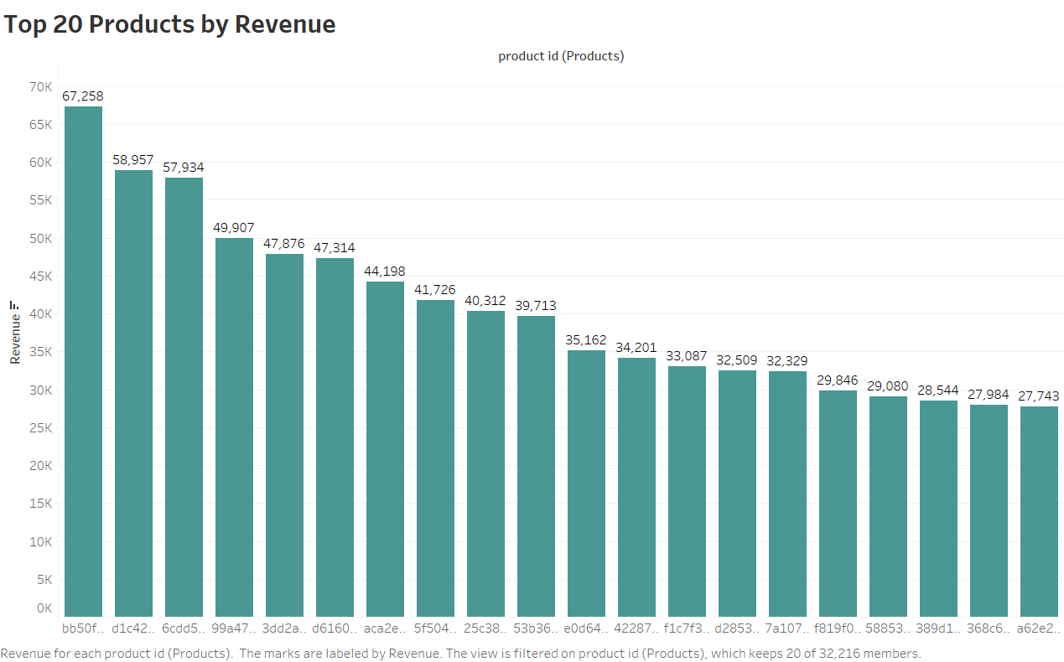
This bar shows the Top 20
Products by Revenue.
The Highest Revenue a particular product has generated is 67,285.

Slide 9
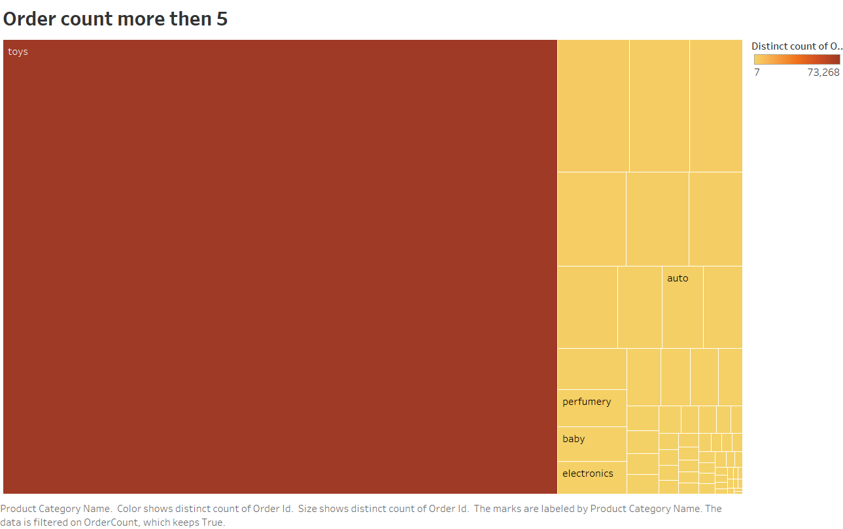
This tree map shows us the quantity of order more than 5
We can see that the distinct count of orders are minimum 7 and maximum 73,268

Slide 10
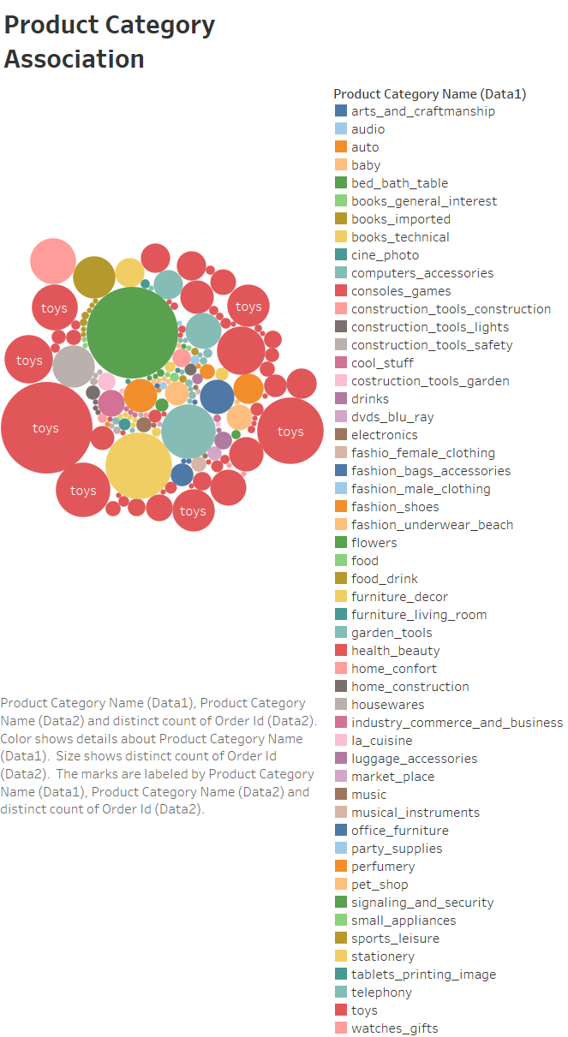
This chart gives us the product category association through market basket analysis , which gives us the fr equent number of orders for this product category association.
Through bubble chart we can see that toys and bed_bath_table has highest orders which is 291.

Slide 11
Recommendations
The Olist company should focus on the customers who are purchasing the more frequent orders of product category toys , as it’s generates more amount of revenue for the company.
Target customers should be the newly becomes parents as are trying to buy toys for their new born.
As company tries to manage inventory so it should removes all the product category who’s products are not ordered regularly.

Slide 12
APPENDIX – Methodology Document:
I conducted a complete analysis of the Olist data. The process included:
Cleaning the data set using numpy, pandas through jupyter notebook.
Using tableau desktop I have generated the different visualization to get the meaningful insights.

